Slide 1




Investigation of Hydrogen in Sodium and Argon Environments
Jyotiraditya Kuanar
Junior Research Fellow
Computer Science
Under guidance of
Dr. Rajesh Ganesan
Associate Director,
MC&MFCG
IGCAR, Kalpakkam
17th November 2025

Slide 2

Background
  Inside a Sodium-Cooled Fast Reactor
  The nuclear fission reaction in the reactor core generates large amounts of heat in fuel rods.
  This heat is removed by liquid sodium coolant circulating through the reactor core.
Sodium Heat Extraction Process
  Primary sodium loop:
  Hot liquid sodium flows around fuel assemblies, absorbing the fission heat.
  The temperature rises to about 525 °C at the reactor outlet.
  The heated sodium transfers energy to the secondary sodium loop through an intermediate heat exchanger (IHX).
  This separation ensures that radioactive primary sodium never contacts water or steam directly.

Slide 3
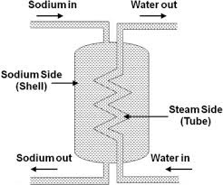
Background
  Steam Generation
  In the secondary loop, cooler sodium (≈ 355 °C at inlet) flows in the opposite direction.
  The heat is transferred from sodium to high-pressure water (≈ 150 bar) in the steam generator, producing superheated steam for the turbine.
  Opposite Flow Mechanism
  Sodium and water/steam flow in counter-current directions across thin-walled ferritic steel tubes (~3–4 mm thick).
  This ensures efficient heat exchange and a strong temperature gradient, maximizing thermal efficiency.

Slide 4
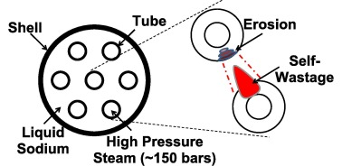
Background
  A tube defect allows high-pressure steam to leak into hot sodium, triggering the sodium–water reaction.
  The reaction forms corrosive NaOH, which attacks the leaking tube.
  This corrosion widens the leak and promotes self-wastage of the tube material.
  The large pressure gradient and NaOH further erode nearby tubes, causing rapid damage propagation.

Slide 5
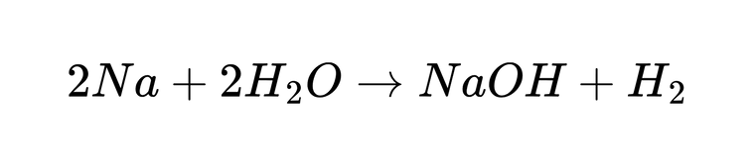
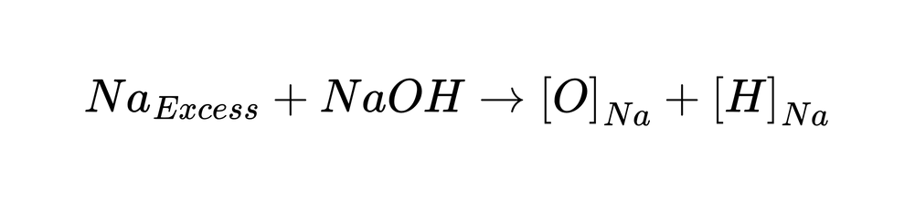
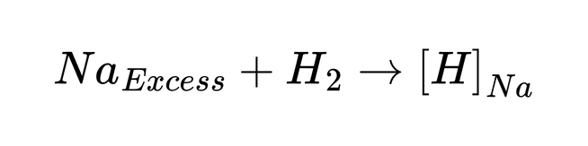
Background
Sodium-cooled fast reactors (SFRs) use liquid sodium as coolant and argon as cover gas.
Steam leaks in the sodium-water heat exchanger cause immediate Na–H₂O reactions:
The generated hydrogen either:
  Escapes to argon cover gas (low T).
  Dissolves in liquid sodium (high T)
Early detection of H₂ is critical for reactor safety and avoiding tube rupture propagation.

Slide 6
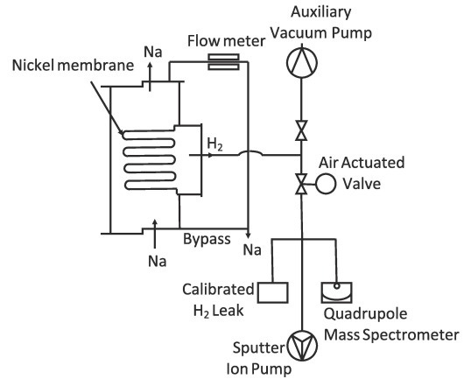
CDHM Sensor

Slide 7
CDHM Sensor
  A thin-walled nickel membrane separates flowing sodium from the high-vacuum region.
  Under dynamic high-vacuum conditions, hydrogen diffuses through the hot liquid sodium and enters the vacuum side through the nickel membrane.
  A high voltage applied in the vacuum region ionizes the diffused hydrogen atoms.
  The Sputter Ion Pump (SIP) measures the resulting ionic current, which is calibrated to determine hydrogen concentration in sodium.
  A Quadrupole Mass Spectrometer (QMS) operates alongside the SIP to further analyze and confirm the hydrogen concentration in sodium.

Slide 8
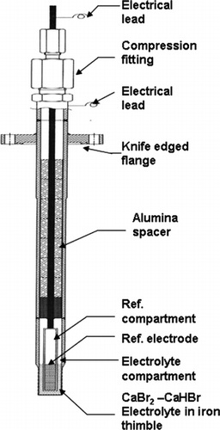
ECHM Sensor
0.5 mm iron

Slide 9
Sensor Materials & Internal Structure
  Electrolyte: Solid Ca + CaBr₂ mixture → becomes CaHBr + CaBr₂ when H₂ passes through.
  Reference Electrode: Biphasic Mixture(Ca, Mg, CaH₂) prepared on SS rod tip.
  Electrolyte placed at base of iron casing; electrode inserted using SS rod.
  7 aluminium spacers added to prevent rod bending and electrical shorting.
SS: Stainless Steel

Slide 10
Working Principle & Sealing
  H₂ diffuses through 0.5mm Pure Iron, ionizes at electrolyte surface.
  Moves toward Ca/CaH₂ electrode, generating a Nernst voltage proportional to H₂ concentration in sodium.
  Voltage measured between SS rod and casing.
  Casing sealed with Teflon cork + secondary cork to prevent H₂ leakage and ensure long sensor life.
  Electrode must maintain a 5 mm gap from electrolyte base.

Slide 11
Casting, Cooling & Issues
  Meter heated to 800 °C (2 hrs) to melt electrolyte; SS rod inserted to marked point (maintains 5 mm gap).
  Cooling done gradually for homogeneous electrolyte distribution.
  Manual handling may cause cracks.
  Improper cooling may create voids, affecting calibration & stability.
800°C
30 mins
20mins
700°C
1 Hr
11 Hrs
2.4 Hrs
450°C
1 Hr
3.5 Hrs
Room Temperature

Slide 12
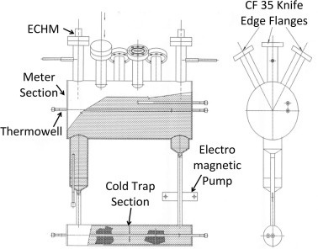
Sodium Loop
  Total sodium inventory: ~8 kg
  Loop consists of meter section and cold trap, connected by SS tubes
  Meter section has six ports; all sections heated by resistance heaters
  Electromagnetic pump circulates sodium
  Cold trap packed with SS mesh to remove oxides & hydrides
  Thermowells in meter and cold trap; thermocouples monitor temperatures
  ECHM sensors placed in meter section for response measurement

Slide 13
Sensor Response Monitoring
  R + ECHM response tracked during cold trap temperature variations
  Stable EMF recorded at each constant cold trap temperature
  Temperature cycled (heating, cooling, random) for 3 months to ensure reproducibility

Slide 14
ECHM Sensor
Strengths:
  High sensitivity, compact, low maintenance.
  Reliable for >450°C reactor conditions.
Limitations:
  Electrolyte degradation, corrosion, drift over long use.
  Calibration difficult due to temperature-dependent solubility.
  Response time slower than gaseous sensors.

Slide 15
Gaps in Sodium Sensor Tech
  EMF drift & temperature nonlinearity
  Slow sensor dynamics
  Material degradation reducing the lifetime of the sensor
  Formation of cracks in the sensor cause irregular readings

Slide 16
Hydrogen in Argon Detection
  Below 400°C, hydrogen escapes into argon cover gas.
  Thermal Conductivity Detector (TCD) and SnO₂ sensor used.
  TCD measures difference in thermal conductivity between pure Ar and Ar+H₂.
  SnO₂ senses hydrogen when surface oxygen ions (O⁻) react with H₂ to form H₂O, releasing electrons back into the semiconductor and reducing its resistance.

Slide 17
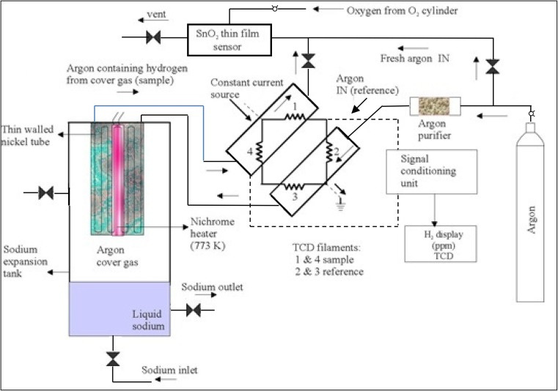
HAD Implementation

Slide 18
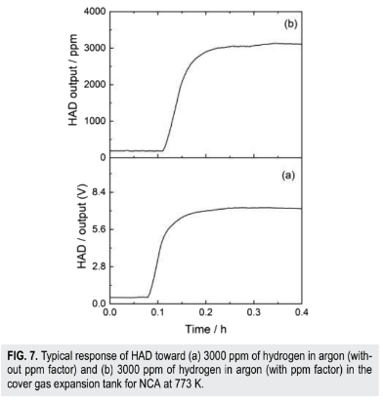
TCD Operation (Carrier & Sample Flow)
  The TCD uses four filaments arranged as a Wheatstone bridge: two for reference gas (argon carrier) and two for sample gas (cover gas).
  Bypass mode:
    Argon carrier enters the reference side of the TCD.
    It bypasses the Ni diffuser assembly (component B).
    It returns to the sample side and exits through the outlet tube into the atmosphere.
  Sample mode:
    Carrier gas enters the reference side of the TCD.
    It flows through the Ni diffuser tube, sweeping any dissolved or leaked H₂.
    It then enters the sample side and is vented out.
  Flow rate: About 30 ml/min of argon flows through the TCD filaments, previously controlled by an MFC.
Range: 30ppm - 3000ppm

Slide 19
Metal Oxide Sensor Working
Formation of surface oxygen ions
    SnO₂ supplies electrons to the surface:
            Sn²⁺ → Sn⁴⁺ + 2e⁻
    Oxygen adsorbs and forms different ions depending on temperature:
      O⁻ dominates at intermediate temperatures (≈150–300 °C)
      O²⁻ dominates at higher temperatures (≥300 °C)
    Example ion-formation step:
            O₂ + e⁻ → O⁻

Slide 20
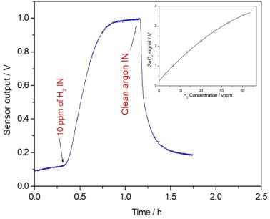
Metal Oxide Sensor Working
Range: 10ppm - 1000ppm
  Reaction of hydrogen with surface oxygen
    Hydrogen reacts with the adsorbed oxygen ions:
            H₂ + O⁻ → H₂O + e⁻
    (At higher temperatures: H₂ + O²⁻ → H₂O + 2e⁻)
  Effect on sensor signal
    The reaction releases electrons back into SnO₂,
    reducing the surface depletion layer,
    causing a drop in resistance, which is detected as the hydrogen signal.

Slide 21
Insights from HAD Study
  Temperature correction vital to minimize electronic noise.
  Carrier gas flow, pressure, and Ni membrane temperature significantly influence hydrogen diffusion across the nickel coil.
  HAD sensitivity increased with higher Ni temperature (0.72 V/bar at 798 K).
  Stable hydrogen detection requires constant flow, fixed bridge current, and controlled cover-gas pressure, ensuring minimal drift.
  Future improvements focus on improved electronics, better shielding, and advanced signal compensation to further reduce noise and enhance reliability.

Slide 22
Cover Gas Gaps & AI Potential
  Flow-rate & temperature drift
      Papers show drift from ambient temp & flow sensitivity.
    AI: Kalman/LSTM filtering for real-time drift correction.
  TCD/Ni membrane stability
      Filament aging, diffusion efficiency vary with use.
    AI: Predictive-maintenance models for sensor health.
  Baseline drift
      Uncorrected HAD noise ±230 mV → ±2.4 mV after correction.
    AI: Denoising autoencoders for continuous baseline correction.

Slide 23
Effect of Ambient Temperature on MFC & HAD Output
  Liquid sodium temperature in the plant varies between 473–773 K, with higher temperatures during normal operation.
  This causes ambient temperature variation between 300–323 K.
  Ambient temperature changes affect the Mass Flow Controller (MFC) performance.
  Temperature variation introduces thermal noise, disturbing the HAD (Hydrogen-in-Argon Detector) output.

Slide 24
Major Gap Area
  At >400 °C, due to faster reaction kinetics, NaOH and H₂ react quickly with sodium → hydrogen dissolves rapidly → use ECHM/SIP to monitor dissolved H₂.
  At <300 °C, reaction kinetics are slow → hydrogen does not dissolve fully → escapes into argon cover gas → use TCD/SnO₂ to monitor gaseous H₂.
  In the 250–400 °C transition zone, both gaseous and dissolved hydrogen coexist → dual sensor responses (SnO₂/TCD + ECHM/SIP) cause ambiguous or delayed detection.
  No established correlation between hydrogen concentration, electromagnetic impulse, and temperature in this transition region.

Slide 25
AI Usage and Implementation
Signal Interpretation & Noise Reduction
  AI can remove baseline drift caused by temperature, flow-rate changes, and corrosion using LSTM, Gaussian Processes, or Kalman-NN models.
  AI can enhance weak or noisy signals using denoising autoencoders or adaptive filters to reliably detect low-level or transient H₂ events.
Calibration & Compensation
  AI models can learn complex calibration curves (neural nets, SVR - Support Vector Regression), reducing or eliminating frequent manual calibration.
  Physics-informed ML can automatically compensate for variations in temperature, sodium purity, and impurity levels using combined thermodynamics + empirical data.

Slide 26
AI Usage and Implementation
Sensor Health Monitoring & Predictive Maintenance
  AI can detect early electrolyte degradation or electrode poisoning by identifying anomalies in EMF/TCD baseline patterns.
  AI can optimize recalibration intervals using drift trend analysis and reinforcement learning, extending sensor life.
Data Fusion & Virtual Hydrogen Sensing
  AI can fuse data from TCD, ECHM, pressure, and temperature sensors to generate a virtual hydrogen sensor that remains stable even when one sensor drifts.
  Hybrid physics + ML can estimate real-time hydrogen concentration even with sparse, slow, or delayed CDHM measurements.

Slide 27

AI Usage and Implementation
Anomaly & Leak Detection
  Time-series AI can detect rapid Na–H₂O reaction leaks by identifying sudden deviations in EMF, sodium temperature, or pressure.
  High-frequency pattern detection can detect tiny hydrogen ingress events below manual threshold limits.
Design & Optimization
  AI-driven materials search can identify corrosion-resistant electrolytes and durable electrode materials for future ECHM/TCD sensors.
  AI-assisted CFD surrogate models can optimize sensor geometry and flow paths, improving response time, sensitivity, and long-term stability.

Slide 28
Hydrogen Management System
A centralized web-based platform for real-time hydrogen monitoring and safety.
  Continuously tracks hydrogen levels from sensors installed in critical areas
  Provides instant visibility through a simple, user-friendly web dashboard
  Sends alerts during abnormal hydrogen buildup to support quick decision-making
  Enhances plant safety, reduces manual monitoring, and ensures early detection of hazards
  Scalable solution that can integrate multiple sensors and multiple plant zones

Slide 29
Expected Outcomes
  Reliable multi-environment hydrogen monitoring method.
  Established relation between temperature, Hydrogen conc. and Electrical Impulse at temperatures 250 °C – 400 °C
  Improved accuracy, stability, and detection limits (<30 ppm).
  AI-assisted calibration and drift correction.
  Framework for fail-safe sodium reactor health monitoring.

Slide 30
Integrated Methodology & Future Scope
  Combine sodium (ECHM) and argon (HAD/TCD) sensor data for holistic leak detection.
  Use sensor fusion models to correlate H₂ dynamics across phases.
  Develop AI-driven signal correction and digital twin simulation for predictive safety.
  Create a “Hydrogen Health Index” indicating reactor leak likelihood in real time.

Slide 31
THANK YOU

